Slide 1
Alexander Schulz & Nicolas Apostolopoulos Freie Universität Berlin
10 Years E-Exams at Freie Universität Berlin
An Overview

Slide 2
FU E-Examinations
Structure
Development of the E-Examination Unit
The E-Examination Center
Topics of the E-Examination Unit
Further information

Slide 3
Step I: Blended-Learning: The Statistical Lab (2003-2006)
Project New Statistics (Neue Statistik)
Improving the statistical education by using a didactical tool
Goal: making e-learning wholistic by
using the Statistical Lab (Statistiklabor) not only during the semester as a learning tool, but
as an examination tool aswell in an open-book scenario

Slide 4
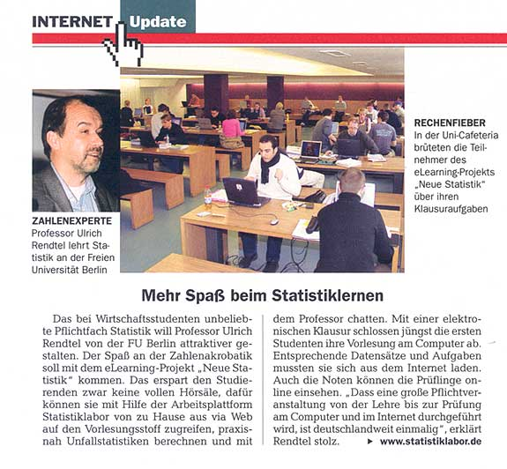
Step I: Prototypal E-Examinations in Statistics (2003-2006)
Focus News Magazin 12/2005 of 03.21.2005, p. 98

Slide 5
Step II: Extending the Topic „E-Examinations“ (2007 – 2010)
Project FU E-Examinations - „Digital Lecture and Examination Hall“
Evaluation of e-exam software solutions
Renovation of lecture halls into laptop examination rooms
Identification of the legal topics
Goal:
Remedy for massively increased amount of examinations resulting from the european Bologna Process for all course of studies not only statistics
Wholistic e-learning up to the examination
Make use of students‘ laptops (BYOD)
Creating the basis for a university wide institutionalization

Slide 6
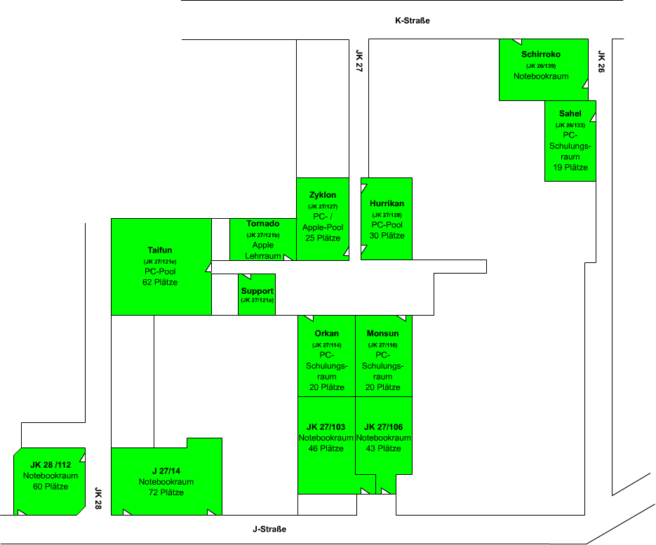
Step II: Central PC-Pools and Laptop Examination Halls (2008)
1. Capacities (2008)
Total: 300 seats CeDiS Lecture Halls: 221 seats
ZEDAT Lecture Halls: 79 PCs
2. Additional Capacities
Total: 117 PCs
ZEDAT PC-Pools: 117 PCs

Slide 7
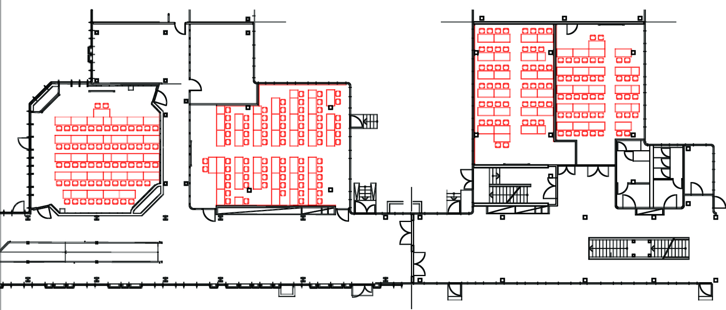
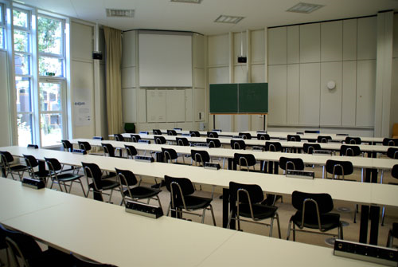
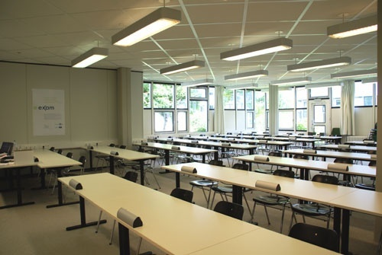
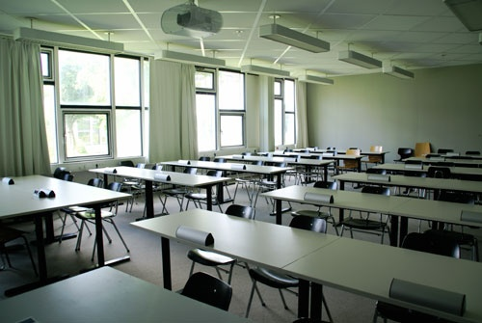
Step II: Laptop Examination Halls (2008)
JK 28/112 60 seats
JK 27/14 72 seats
JK 27/103 46 seats
JK 27/106 43 seats

Slide 8
Step II: Laptop Examination Halls in Use (2008)
Examination in Statistics (Summer Semester 2008) Prof. U. Rendtel & Dr. A. Ghosh

Slide 9
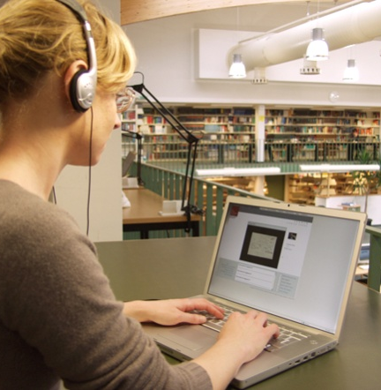
Step II: Using Student‘s Notebooks in a Nutshell (2010)
Advantages of BYOD:
High flexibility (when and where)
Students use their devices
University:
Reduced hardware costs
fewer PC-pools required
BYOD examination halls can also serve a normal lecture hall purpose
Disadvantages of BYOD:
Hardware heterogenity of devices leads to higher demand for tech support
Technical config required to ensure safety from cheating on a BYOD
In Germany: legal concerns from the non-discrimination precept

Slide 10
FU E-Examinations
Structure
Development of the E-Examination Unit
The E-Examination Center
Topics of the E-Examination Unit
Further information

Slide 11
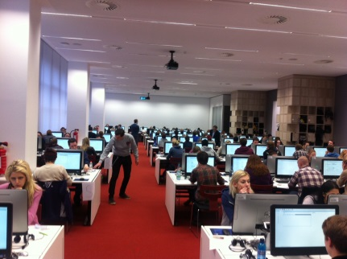
Step III: Implementation, institutionalization and extension (since 2011)
Technical implementation:
2011-2012: Conception and installation of a high performance cluster for the exam plattform (with LPLUS)
Construction of the E-Examination Center (EEC):
2012-2013: Setting up the E-Examination Center (EEC)
Bringing into service on Feb 2nd, 2013 with an exam of the former vice president of Freie Universität Berlin: Prof. Dr. Klaus Beck
More than 150 computer stations for exams
Most modern examination center in Germany
Second largest capacity of all examination centers in Germany

Slide 12
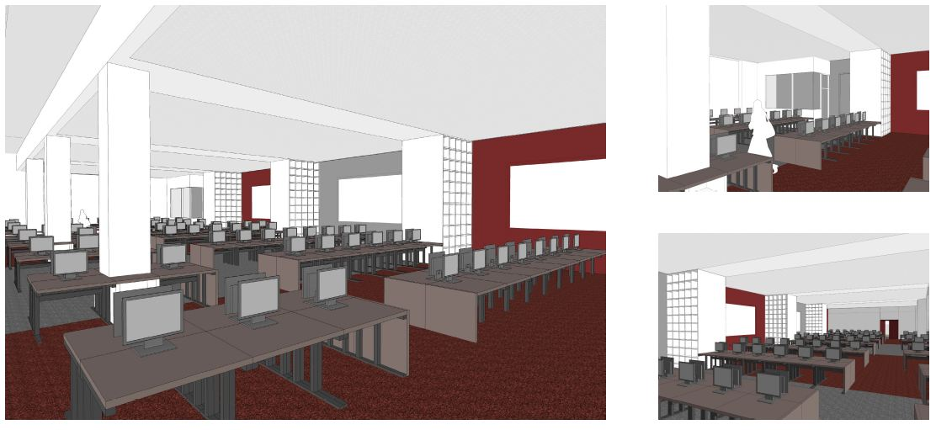
Step III: The E-Examination Center - 3D-simulations in November 2011
Source: Gewers & Pudewill Architekten Berlin

Slide 13
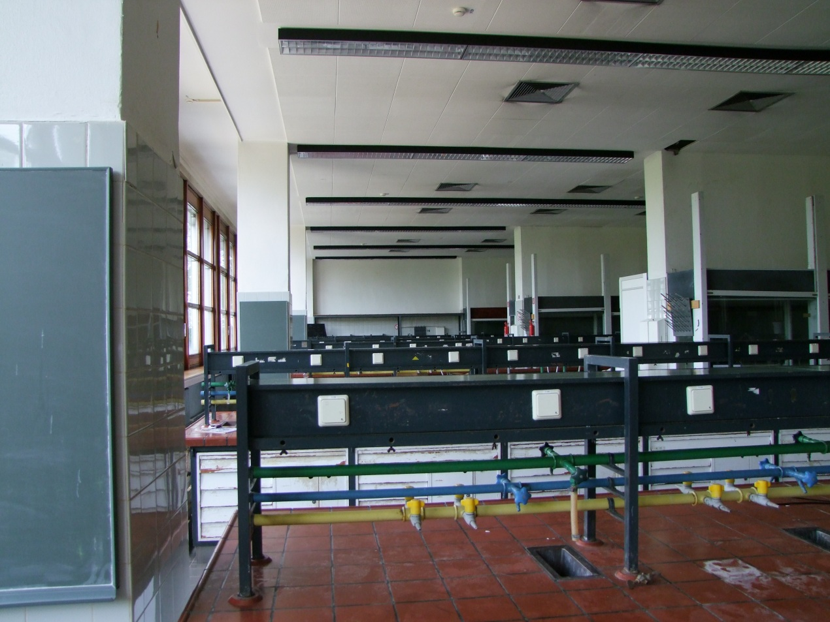
Step III: The EEC in January 2012

Slide 14
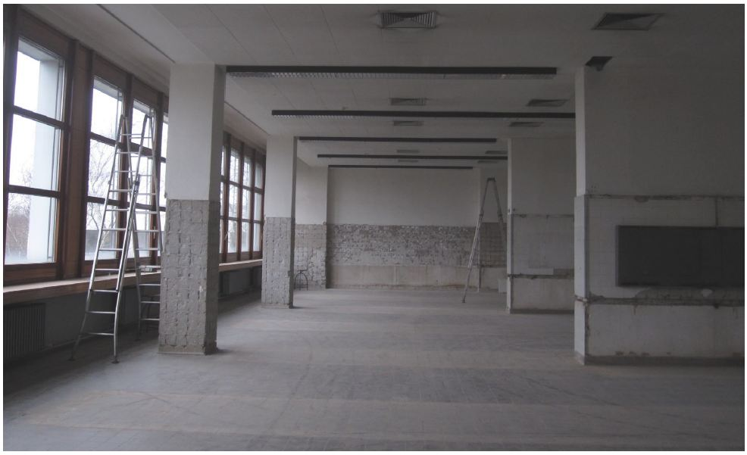
Step III: The EEC in April 2012

Slide 15
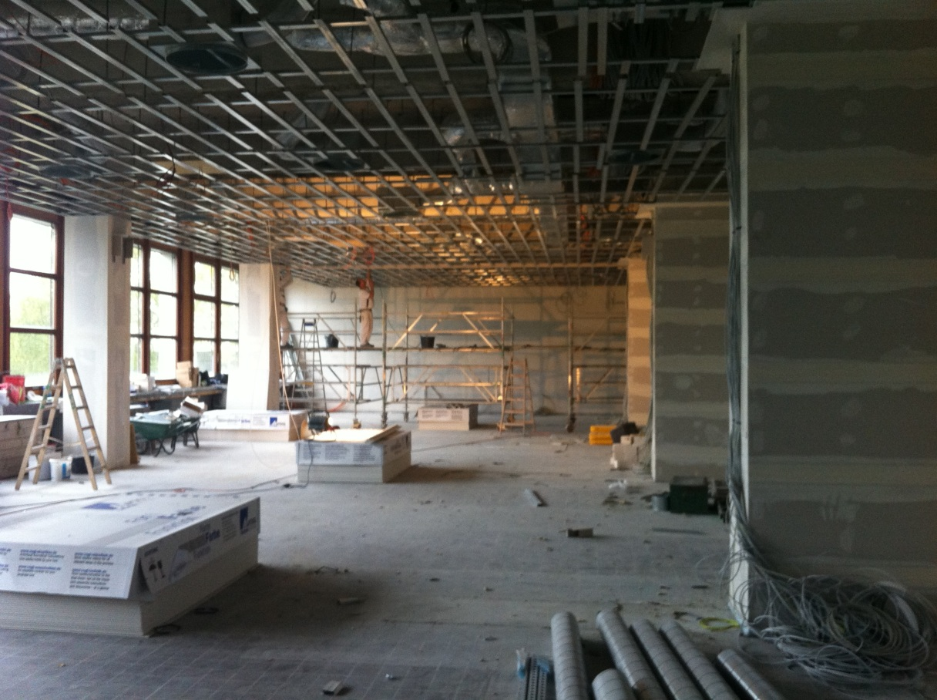
Step III: The EEC in October 2012

Slide 16
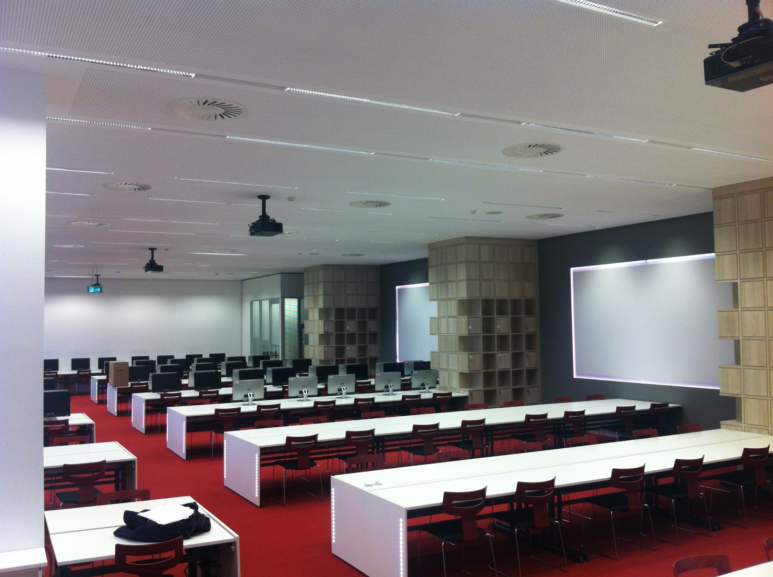
Step III: The EEC in December 2012

Slide 17
Step III: The first E-Examinations in February 2013

Slide 18
Step III: Frame Conditions (2011-2014)
Setting a Support-Team:
Since 2011: 1,5 x scientific employees
Since 2013: 1,5 x scientific employees + 2 students
Legal Basis:
Since 2013: Basis for E-Examinations is regulated in the university wide „Rahmenstudienprüfungsordnung (RSPO)“ (~ Legal Framework for Studies and Examinations at Freie Universität Berlin)
Operational Concept:
Fixed budget for the unit (first until 2016)

Slide 19
Step III: The E-Examination Center in a Nutshell (2011-2014)
Advantages:
Infrastructure entirely in our hands
Configurability of the Exam-PCs
Homogenity of Exam-PCs
Low personal costs for administration
Disadvantages:
Initially high investment
Lower flexibility of the hall (configuration for legally safe examinations)
Follow-up investments inevitable

Slide 20
Step III: Current Ratio of the EEC - Single Tests (ST)
Year | ST | Prediction
2011 | 1.700
2012 | 2.900
2013 | 8.400 | 6.000
2014 | 7.300 (Jan-Aug) | 9.500
Since the initiation of the EEC in February 2013, 168 examinations were conducted with more than 15.700 single tests (~ participants examined) .

Slide 21
FU E-Examinations
Structure
Development of the E-Examination Unit
The E-Examination Center
Topics of the E-Examination Unit
Further informations

Slide 22
Topics of the E-Examination Unit
Logistics
Didactics
Technology
Psychology
Quality
and Efficiency
Senken der Einstiegshürden
Gewährleisten von Systemsicherheit
Legal Questions and Data Privacy

Slide 23
Topics of the E-Examination Unit: Logistics
Logistics
Original Question 2007: How to deal with groups of participants of up to 600 ppl?
Educational Science,
Economic Science
Political Science
Psychology
Altered Question 2012: How to deal with groups of participants of up to 3,000 ppl?
Medical Science
Didactics
Technology
Psychology
Quality
and Efficiency
Senken der Einstiegshürden
Gewährleisten von Systemsicherheit
Legal Questions and Data Privacy

Slide 24
Topics of the E-Examination Unit: Didactics
Intention?
How should the learning contents be examined?
Testing factual knowledge or apply knowledge to a case?
Types of Exams (see Crisp 2009)
Diagnostical exams
Formative exams
Summative exams
Logistics
Didactics
Technology
Psychology
Quality
and Efficiency
Senken der Einstiegshürden
Gewährleisten von Systemsicherheit
Legal Questions and Data Privacy

Slide 25
Topics of the E-Examination Unit: Psychology
Exam nervs
Reducing the media discontinuity
Environment optimized for concentrated attention
Fundamental fears
Prejudice: technology is not suffiently reliable
Procedures to deal with the participants
Standardized rhetorical workflows for
PC crashs
Evacuation of the building in case of emergency
Server Crashs (never happened)
Logistics
Didactics
Technology
Psychology
Quality
and Efficiency
Senken der Einstiegshürden
Gewährleisten von Systemsicherheit
Legal Questions and Data Privacy

Slide 26
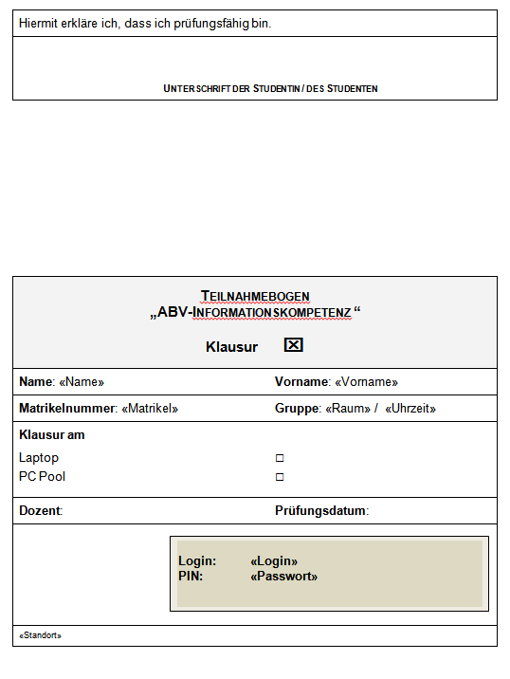
Topics of the E-Examination Unit: Legal Implications
Examination regulations:
„The electronic examination can thus not be considered as a type of a written examination (..)“ (see Niehus/Fischer 2010) „Die elektronische Prüfung ist in diesem Zusammenhang nicht als eine Art schriftliche Prüfung zu verstehen (..)“
Every faculty has its individual examination regulation
Every federal land has specific education regulations
Data protection
Minimization of personal data
Storing of examination data for 3 semesters only
Logistics
Didactics
Technology
Psychology
Quality
and Efficiency
Senken der Einstiegshürden
Gewährleisten von Systemsicherheit
Legal Questions and Data Privacy

Slide 27
Topics of the E-Examination Unit: Quality and Efficiency (1)
Quality assurance:
Statistical evaluation of examination results
Macroscopic: comparison of students/cohorts
Microscopic: comparison of questions (item-total correlation)
Question log reports (when and how long did a student run a specific question?)
Improving efficiency
Saving time (mostly) by being able to read the students‘ answers
Exams are much faster evaluated and thus marked
Which effects can be measured when migrating traditional paper-pencil exam almost 1:1 to computerbased e-examinations?
Logistics
Didactics
Technology
Psychology
Quality
and Efficiency
Senken der Einstiegshürden
Gewährleisten von Systemsicherheit
Legal Questions and Data Privacy

Slide 28
Topics of the E-Examination Unit: Quality and Efficiency (2)
Jurisprudence: SR questions
Position | time | remarks
57,800€ | year | 12 mths
250€ | day | 231 workdays
Description | Paper-Pencil | E-Examination
Amount of questions | 40 | 40
Duration of grading per single test (min)* | 8 | 0.5
Amount of graded tests per day | 54.86 | 877.68
Total duration in days for 175 Stud. | 3.19 | 0.20
Weeks | 0.64 | 0.04
Costs (position) | 820€ | 50€
Saved costs for 175 students |  | 770€
Logistics
 | time
week | 36.57h
day | 7.314h
day | 438.84min
Didactics
Technology
* Sample = 10 exams
Psychology
Quality
and Efficiency
Model calculation for 100 students
Total duration in days | 1.82 | 0.11
Costs (position) | 460€ | 30€
Saved costs for 100 students |  | 430€
Saved costs in percent |  | 93%
Senken der Einstiegshürden
Gewährleisten von Systemsicherheit
Legal Questions and Data Privacy

Slide 29
Topics of the E-Examination Unit: Quality and Efficiency (3)
Educational science: CR questions
Position | time | remarks
57,800€ | year | 12 mths
250€ | day | 231 workdays
Description | Paper-Pencil | E-Examination
Amount of questions | 15 | 15
Duration of grading per single test (min)* | 75 | 50
Amount of graded tests per day | 5.85 | 8.78
Total duration in days for 181 Stud. | 30.93 | 20.62
Weeks | 6.19 | 4.12
Costs (position) | 7,700€ | 5,200€
Saved costs for 181 students |  | 2.200€
Logistics
 | time
week | 36.57h
day | 7.314h
day | 438.84min
Didactics
Technology
* Sample = 10 exams
Psychology
Quality
and Efficiency
Model calculation for 100 students
Total duration in days | 17.09 | 11.39
Costs (position) | 4,300€ | 2,900€
Saved costs for 100 students |  | 1.400€
Saved costs in percent |  | 33%
Senken der Einstiegshürden
Gewährleisten von Systemsicherheit
Legal Questions and Data Privacy

Slide 30
Topics of the E-Examination Unit: Quality and Efficiency (4)
Logistics
Amount of e-exams
Didactics
Technology
Examination duration in minutes
Psychology
Quality
and Efficiency
Senken der Einstiegshürden
Research question (break even): How many e-exams are required per year to amortize a BATIIa position?
Gewährleisten von Systemsicherheit
Legal Questions and Data Privacy

Slide 31
Topics of the E-Examination Unit: Quality and Efficiency in a Nutshell (5)
SR Exams:
Percentaged higher rationalization
Effectively lower rationalization
Profitable only by doing masses of examinations
CR Exams:
Percentaged lower rationalization
Effectively higher rationalization
Profitable even with lower amounts of examinations
Logistics
Didactics
Technology
Psychology
Quality
and Efficiency
Senken der Einstiegshürden
Gewährleisten von Systemsicherheit
Legal Questions and Data Privacy

Slide 32
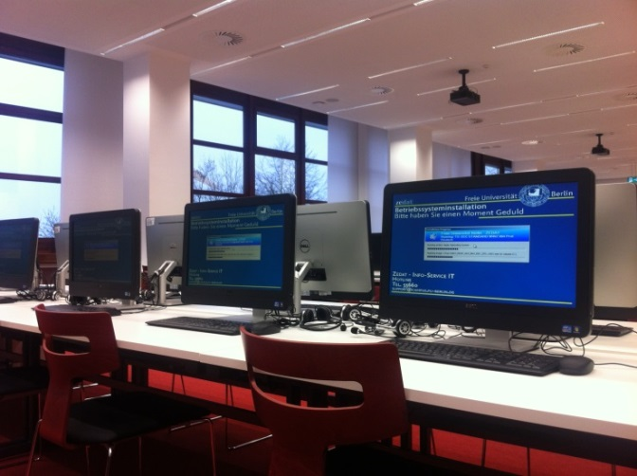
Topics of the E-Examination Unit: Technology (1)
PCs:
Homogenous end user devices (silent AIO Dell-PCs)
Standardized Windows 7 image (distributed from a central imaging server)
Extra silent Cherry keyboards
Infrastructure and basic security
LAN connection only
Web access limited to the examination platform
Logistics
Didactics
Technology
Psychology
Quality
and Efficiency
Senken der Einstiegshürden
Gewährleisten von Systemsicherheit
Legal Questions and Data Privacy

Slide 33
Topics of the E-Examination Unit: Technology (2)
Examination platform (LPLUS)
Examination platform
1 x production system (dedicated)
1 x test system (virtualized)
Logistics
Didactics
Technology
DB Server 03 – Witness
DB Server 01 – Primary
DB Server 02 - Mirror
Psychology
Quality
and Efficiency
Senken der Einstiegshürden
Gewährleisten von Systemsicherheit
Legal Questions and Data Privacy
NLB
App Server 01
App Server 02

Slide 34
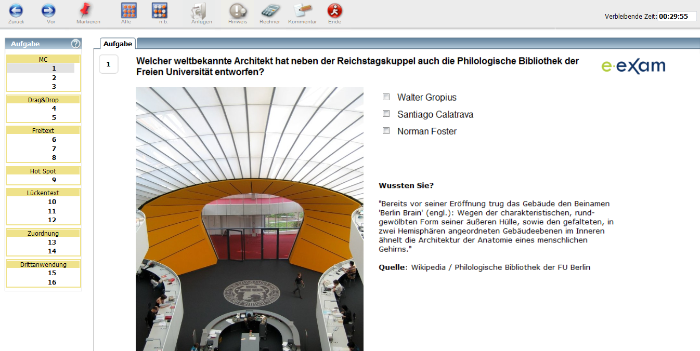
Topics of the E-Examination Unit: Technology – Examination Platform (1)
Logistics
Didactics
Technology
Psychology
Quality
and Efficiency
Many possible question types integrated
Freie Universität is predominantly in the field of social sciences
Thus: 70% of the exams are constructed response design
Senken der Einstiegshürden
Gewährleisten von Systemsicherheit
Legal Questions and Data Privacy

Slide 35
Topics of the E-Examination Unit: Technology – Examination Platform (2)
Reduce Risk of Cheating
Randomization of question order
Randomization of answer order
Create different exams for any student from a group of „equal“ questions.
Secure Browser
Detects being run a VM
Available for Microsoft Windows only
Not in use at Freie Universität at the moment
Stability
Permanent connection to the examination server
SR questions saved immediately on server
QR questions saved every 30secs on server (every revision saved separately)
Logistics
Didactics
Technology
Psychology
Quality
and Efficiency
Senken der Einstiegshürden
Gewährleisten von Systemsicherheit
Legal Questions and Data Privacy

Slide 36
FU E-Examinations
Structure
The e-examination centre
Development of the division e-examinations
Topics of the devision e-examinations
Further information

Slide 37
Further Information
Resources, Literatur and Sources
E-Examinations at Freie Universität Berlin http://www.e-examinations.fu-berlin.de
Crisp, G. (2009): „Interactive e-Assessment: moving beyond multiple choice questions“, Online im Internet: http://eli.elc.edu.sa/2009/content/Crisp%5Bresearch%5D.pdf (last accessed 05/18/2012)
Schulz, A. & Apostolopoulos, N. (2011): „E-Examinations Put To Test – Potenziale Computergestützer Prüfungen“, in: „Hamburger eLearning Magazin - #07 eAssessment auf dem Prüfstand“, Online im Internet: http://www.uni-hamburg.de/eLearning/eCommunity/Hamburger_eLearning_Magazin/eLearningMagazin_07.pdf (last accessed 05/18/2012)
Niehus, N. & Fischer, E. (2010): „Prüfungsrecht - 5. Auflage“, C.H. Beck, München, S.12ff.
„Mehr Spaß beim Statistiklernen“, erschienen in: Focus 12/2005, vom 21.03.2005, S.98, Online im Internet: http://www.statistiklabor.de/de/news/Presseartikel/Focus-12-05/index.html (last accessed 05/18/2005)
Schulz, A. & Apostolopoulos, N. (2014). E-Examinations at a Glance. Die Computerisierung des Prüfungswesens an der Freien Universität Berlin. In T. Škerlak, H. Kaufmann & G. Bachmann (Hrsg.), Lernumgebungen an der Hochschule. Auf dem Weg zum Campus von morgen (S. 283-298). Medien in der Wissenschaft, 66. Münster/New York: Waxmann.

Slide 38
Thank you for your interest
Alexander Schulz & Nicolas Apostolopoulos
www.e-examinations.fu-berlin.de

